Slide 1
The Radioactive Decay Law
The decay process is probabilistic in nature and can be described with statistical calculations for a radioactive substance of macroscopic size containing a large number of radioactive nuclei.
For such large numbers, the rate at which a particular decay process occurs in a sample is proportional to the number of radioactive nuclei present (that is, the number of nuclei that have not yet decayed).

Slide 2
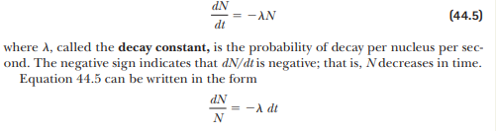
If N is the number of undecayed radioactive nuclei present at some instant, the rate of change of N with time is

Slide 3
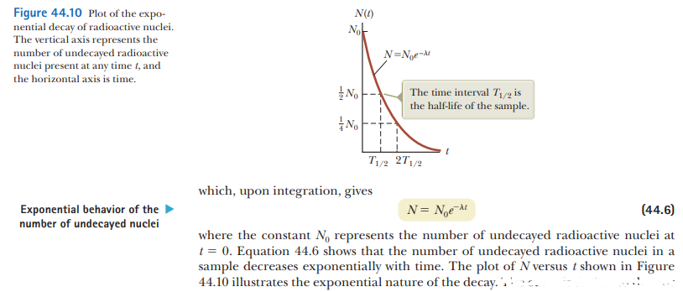

Slide 4
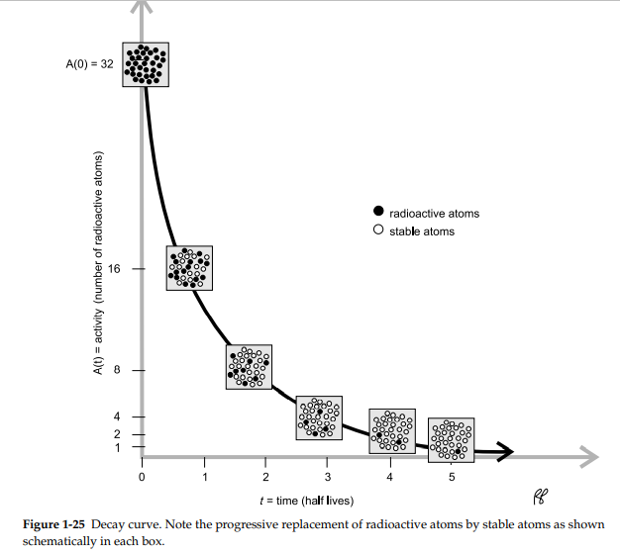

Slide 5
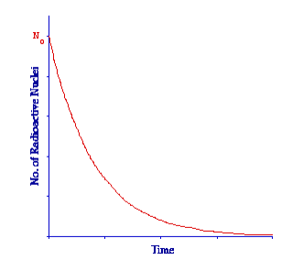
The Law tells us that the number of radioactive nuclei will decrease with time in an exponential fashion with the rate of decrease being controlled by the Decay Constant.
The Law is shown in graphical form in the figure below:
The graph plots the number of radioactive nuclei at any time, Nt , against time, t.
We can see that the number of radioactive nuclei decreases from N0 that is the number at t = 0 in a rapid fashion initially and then more slowly in the classic exponential manner

Slide 6
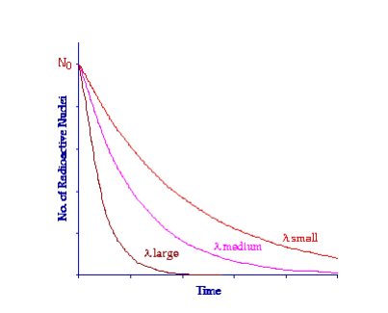
The influence of the Decay Constant can be seen in the following figure:
All three curves here are exponential in nature, only the Decay Constant is different.
Notice that when the Decay Constant has a low value the curve decreases relatively slowly and when the Decay Constant is large the curve decreases very quickly.
The Decay Constant is characteristic of individual radionuclides.
Some like uranium-238 have a small value and the material therefore decays quite slowly over a long period of time.
Other nuclei such as technetium-99m have a relatively large Decay Constant and they decay far more quickly

Slide 7
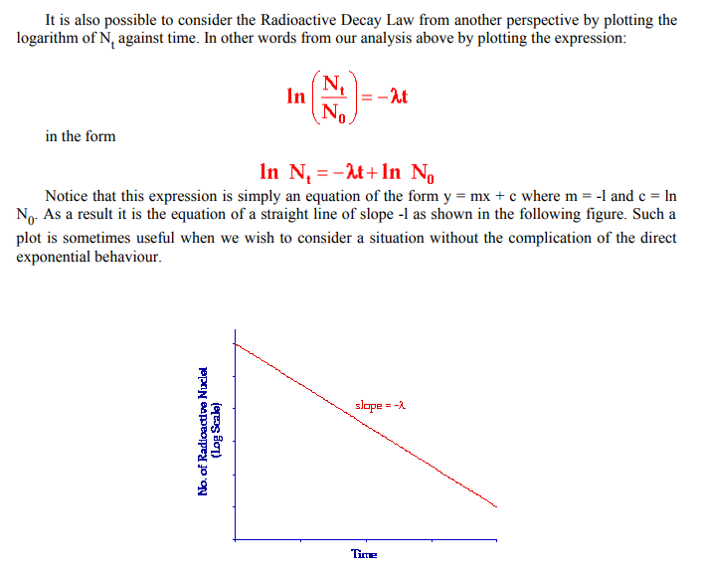

Slide 8
Half-Life
Most of us have not been taught to think instinctively in terms of logarithmic or exponential terms even though many natural phenomena display exponential behaviours.
Most of the forms of thinking which we have been taught in school are based on linear changes and as a result it is rather difficult for us to grasp the Radioactive Decay Law intuitively.
For this reason an indicator is usually derived from the law which helps us think more clearly about what is going on.

Slide 9
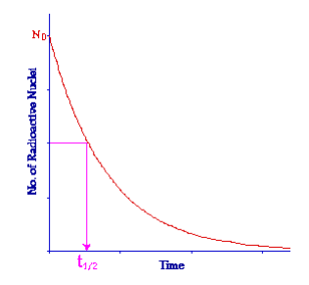

Half-Life
This indicator is called the Half Life and it expresses the length of time it takes for the radioactivity of a radioisotope to decrease by a factor of two.
From a graphical point of view we can say that when:

Slide 10
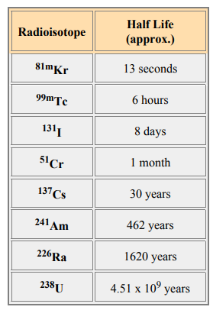
Half-Life
Note that the half-life does not express how long a material will remain radioactive but simply the length of time for its radioactivity to halve.
Examples of the half lives of some radioisotopes are given in the following table.
Notice that some of these have a relatively short half life.
These tend to be the ones used for medical diagnostic purposes because they do not remain radioactive for very long following administration to a patient and hence result in a relatively low radiation dose

Slide 11
Relationship between the Decay Constant and the Half Life
On the basis of the above you should be able to appreciate that there is a relationship between the Decay Constant and the Half Life.
For example when the Decay Constant is small the Half Life should be long and correspondingly when the Decay Constant is large the Half Life should be short.
But what exactly is the nature of this relationship?

Slide 12
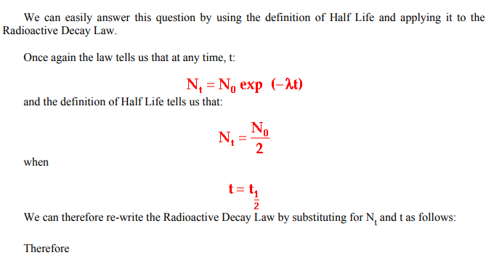

Slide 13
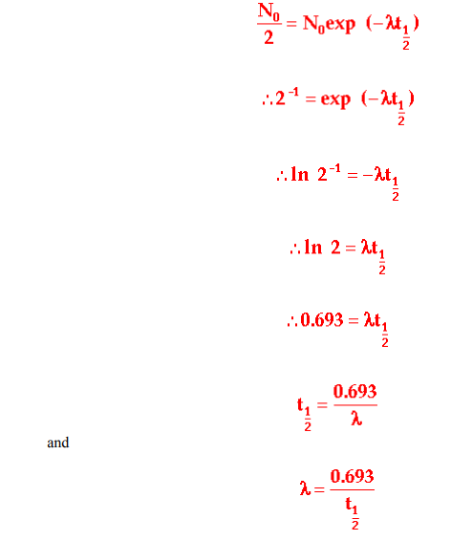
Relationship between the Decay Constant and the Half Life
These last two equations express the relationship between the Decay Constant and the Half Life.
They are very useful as you will see when solving numerical questions relating to radioactivity and usually form the first step in solving a numerical problem

Slide 14
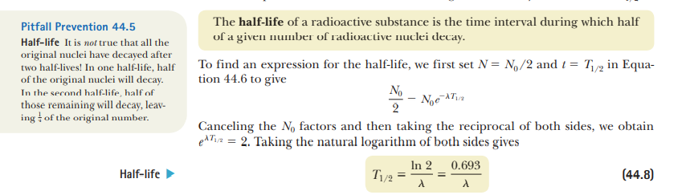

Slide 15
Units of Radioactivity
The SI or metric unit of radioactivity is named after Henri Becquerel, in honour of his discovery of radioactivity, and is called the becquerel with the symbol Bq.
The becquerel is defined as the quantity of radioactive substance that gives rise to a decay rate of 1 decay per second.
In medical diagnostic work 1 Bq is a rather small amount of radioactivity.
Indeed it is easy to remember its definition if you think of it as a buggerall amount of radioactivity.
For this reason the kilobecquerel (kBq) and megabecquerel (MBq) are more frequently used.

Slide 16
Units of Radioactivity
The traditional unit of radioactivity is named after Marie Curie and is called the curie, with the symbol Ci.
The curie is defined as the amount of radioactive substance which gives rise to a decay rate 3 of 3.7 x 1010 decays per second.
In other words 37 thousand, million decays per second which as you might appreciate is a substantial amount of radioactivity.

Slide 17
Units of Radioactivity
For medical diagnostic work the millicurie (mCi) and the microcurie (µCi) are therefore more frequently used.
Why two units?
It in essence like all other units of measurement depends on what part of the world you are in.
For example the kilometer is widely used in Europe and Australia as a unit of distance and the mile is used in the USA.
So if you are reading an American textbook you are likely to find the curie used as the unit of radioactivity, if you are reading an Australian book it will most likely refer to becquerels and both units might be used if you are reading a European book.
You will therefore find it necessary to know and understand both units

Slide 18
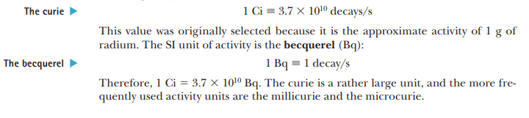

Slide 19
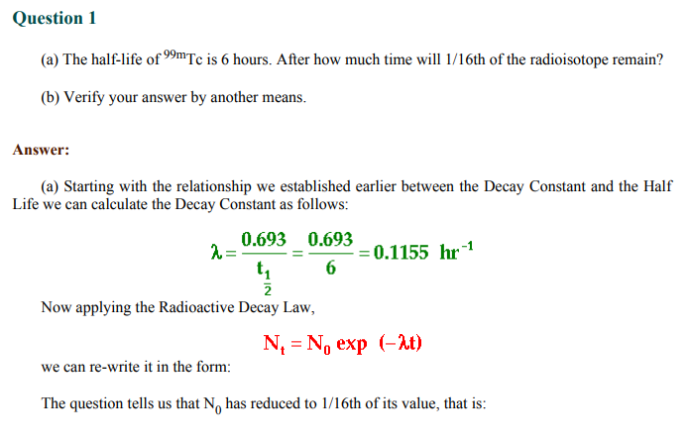

Slide 20
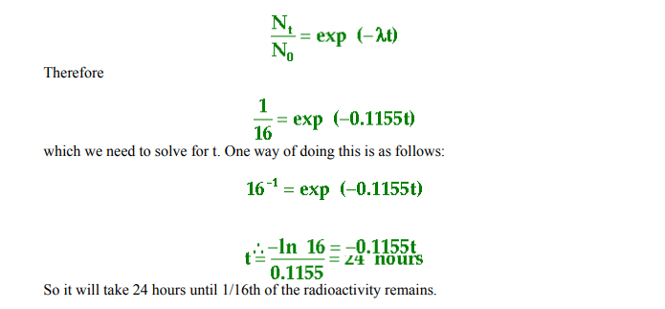

Slide 21

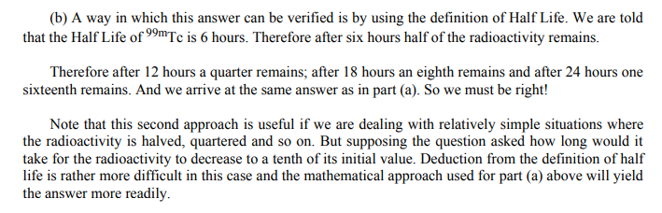

Slide 22
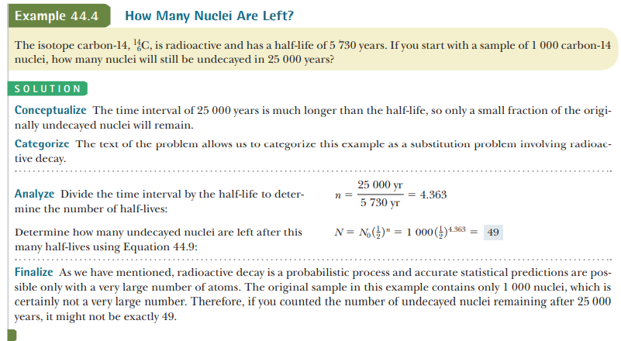

Slide 23
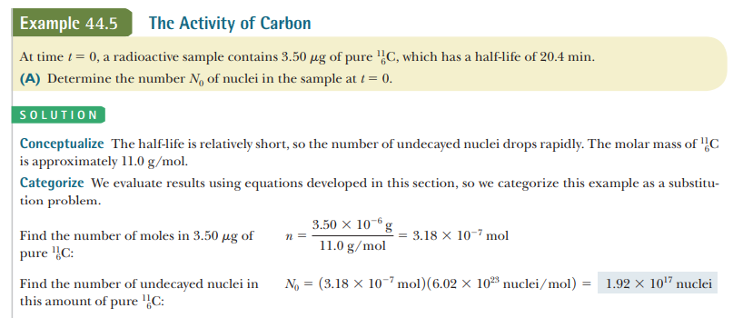

Slide 24
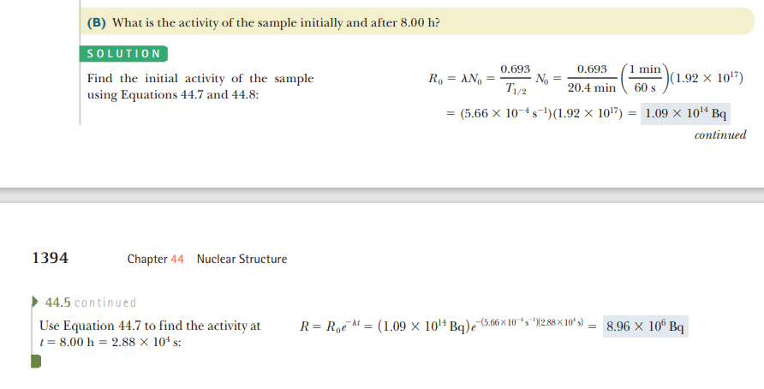

Slide 25
